Slide 1
Physics Subject for High School: Newton's Laws
Here is where your presentation begins

Slide 2
Contents of this template
You can delete this slide when you’re done editing the presentation
Fonts | To view this template correctly in PowerPoint, download and install the fonts we used
Used and alternative resources | An assortment of graphic resources that are suitable for use in this presentation
Thanks slide | You must keep it so that proper credits for our design are given
Colors | All the colors used in this presentation
Icons and infographic resources | These can be used in the template, and their size and color can be edited
Editable presentation theme | You can edit the master slides easily. For more info, click here
For more info: SLIDESGO | BLOG | FAQs
You can visit our sister projects: FREEPIK | FLATICON | STORYSET | WEPIK | VIDEVO

Slide 3
Table of contents
01
02
03
04
Introduction
Laws of Motion
You can describe the topic of the section here
You can describe the topic of the section here
Law of Inertia
Law Balanced
You can describe the topic of the section here
You can describe the topic of the section here

Slide 4
Whoa!
This can be the part of the presentation where you introduce yourself, write your email…

Slide 5
01
Introduction
You can enter a subtitle here if you need it

Slide 6
Introduction to Newton's Laws
Mercury is the closest planet to the Sun and the smallest one in the entire Solar System. Contrary to popular belief, this planet's name has nothing to do with the liquid metal. Mercury was, instead, named after the famous Roman messenger god Mercurius
Mercury takes a little more than 58 days to complete its rotation, so try to imagine how long days must be there! Since the temperatures are so extreme, albeit not as extreme as on Venus, Mercury has been deemed to be non-habitable for humans

Slide 7
Conservation of Momentum
Do you know what helps you make your point crystal clear? Lists like this one:
They’re simple
You can organize your ideas clearly
You’ll never forget to buy milk!
And the most important thing: the audience won’t miss the point of your presentation

Slide 8
Exercise 1: Multiple choice
1. According to Newton's first law of motion, an object at rest tends to stay at rest unless acted upon by
a) A balanced force
b) An unbalanced force
c) Gravity
d) Friction
2. Which of the following is an example of Newton's second law of motion?
a) A ball rolling down a hill
b) A person sitting on a chair.
c) A rocket launching into space.
d) A book resting on a table.
3. According to Newton's first law of motion, an object in motion will continue moving with the same speed and direction unless acted upon by
a) Friction
b) Gravity
c) Air resistance
d) An external force
Look at the answers

Slide 9
Calculating acceleration
Venus
Venus has a beautiful name and is the second planet from the Sun. It’s hot and has a poisonous atmosphere
Mercury
Mercury is the closest planet to the Sun and the smallest one in the Solar System—it’s only a bit larger than the Moon

Slide 10
Balanced and unbalanced
Mercury
Mars
Venus
Mercury is the closest planet to the Sun and the smallest of them all
Despite being red, Mars is actually a cold place. It’s full of iron oxide dust
Venus has a beautiful name and is the second planet from the Sun

Slide 11
Static objects
Jupiter
Saturn
Jupiter is the biggest planet of them all
Saturn is a gas giant and has several rings
Venus
Mars
Venus has extremely high temperatures
Mars is actually a very cold place

Slide 12
Action-reaction pairs
Jupiter
Saturn
Mercury
Jupiter is the biggest planet of them all
Saturn is a gas giant with several rings
Mercury is the closest planet to the Sun
Neptune
Venus
Mars
Neptune is the farthest planet from the Sun
Venus has extremely high temperatures
Mars is actually a very cold place

Slide 13
Awesome words

Slide 14
Exercise 2: Complete concepts
Complete the following sentences with the appropriate terms:
According to Newton's second law of motion, the acceleration of an object is directly proportional to the 1._____________ applied to it and inversely proportional to its 2._____________.
Newton's third law states that for every action, there is an equal and opposite 3._____________.
Newton's third law states that for every action, there is an equal and opposite 4._____________. This law highlights the interplay between interacting objects.
Look at the answers

Slide 15
—Someone Famous
“This is a quote, words full of wisdom that someone important said and can make the reader get inspired”

Slide 16
Forces in equilibrium: Static objects
Images reveal large amounts of data, so remember: use an image instead of a long text. Your audience will appreciate it

Slide 17
Law of universal gravitation
65%
35%
10%
Mars
Venus
Mercury
Despite being red, Mars is actually a cold place. It’s full of iron oxide dust
Venus has a beautiful name and is the second planet from the Sun
Mercury is the closest planet to the Sun and the smallest of them all

Slide 18
03
Law of Inertia
You can enter a subtitle here if you need it

Slide 19
Exercise 3: Match terms
Match the following terms with their corresponding descriptions:
Terms
Descriptions
1. Inertia
a. The tendency of an object to resist changes in its motion
2. Force
b. The tendency of an object to resist changes in its motion
3. Acceleration
c. The tendency of an object to resist changes in its motion
Look at the answers

Slide 20
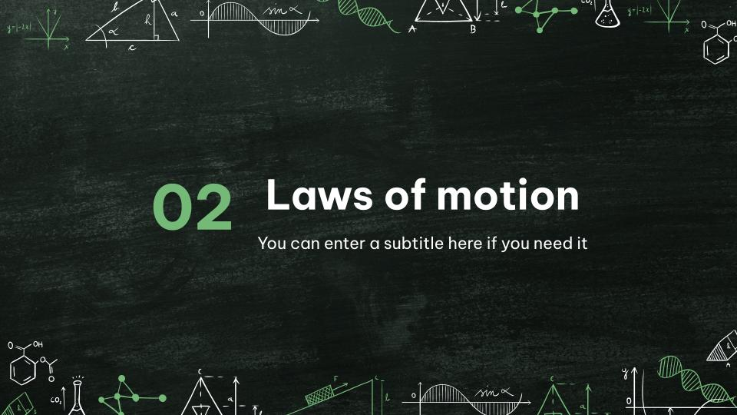
Computer mockup
You can replace the image on the screen with your own work. Just right-click on it and select “Replace image”

Slide 21

Tablet mockup
You can replace the image on the screen with your own work. Just right-click on it and select “Replace image”

Slide 22
Phone mockup
You can replace the image on the screen with your own work. Just right-click on it and select “Replace image”

Slide 23
Newton's laws
Mars
Venus has a beautiful name and is the second planet from the Sun. It’s terribly hot, even hotter than Mercury, and its atmosphere is extremely poisonous

Slide 24
Newton's laws timeline
Venus is the second planet from the Sun
Despite being red, Mars is a very cold place
Earth is the only planet that harbors life
Venus
Mars
Earth
16XX
16XX
17XX
17XX
17XX
Mercury
Jupiter
Mercury is the closest planet to the Sun
Jupiter is the biggest planet of them all

Slide 25
Elastic vs. inelastic
The Moon
Saturn
Saturn is a gas giant with several rings
Neptune
Mars
Neptune is far away from us
Neptune is the eighth planet
Mars is actually a very cold place
Mars is full of iron oxide dust

Slide 26
Applications of Newton's
Newton's laws of motion
Law # 1 | Neptune is the farthest planet from the Sun. It’s also the fourth-largest planet by diameter in the Solar System
Law # 2 | Jupiter is a gas giant and the biggest planet in the Solar System. It’s the fourth-brightest object in the night sky
Law # 3 | Despite being red, Mars is actually a cold place. It’s full of iron oxide dust, which gives the planet its reddish cast

Slide 27

Newton's laws graphic
35%
10%
Mars
Mars is a cold planet
95%
40%
Venus
Venus is a hot planet
15%
60%
Saturn
Saturn is a gas giant
Follow the link in the graph to modify its data and then paste the new one here. For more info, click here

Slide 28
Exercise 4: True/false
Indicate whether the following statements are true or false:
T
F
T
F
1. According to Newton's first law, an object in motion will continue moving at a constant velocity unless acted upon by a net force
2. Newton's second law states that the force acting on an object is equal to its mass times its acceleration
Look at the answers

Slide 29
Exercise answer
Exercise # 1
1.b
2.c
3.d
Exercise # 2
1. Force
2. Mass
3. Reaction
Exercise # 3
1.a
2.b
3.c
Exercise # 4
1. True
2. True

Slide 30
Thanks!
Do you have any questions?
youremail@freepik.com
+91 620 421 838
yourwebsite.com
Please keep this slide for attribution

